Slide 1
Salt Slugs 101

Slide 2
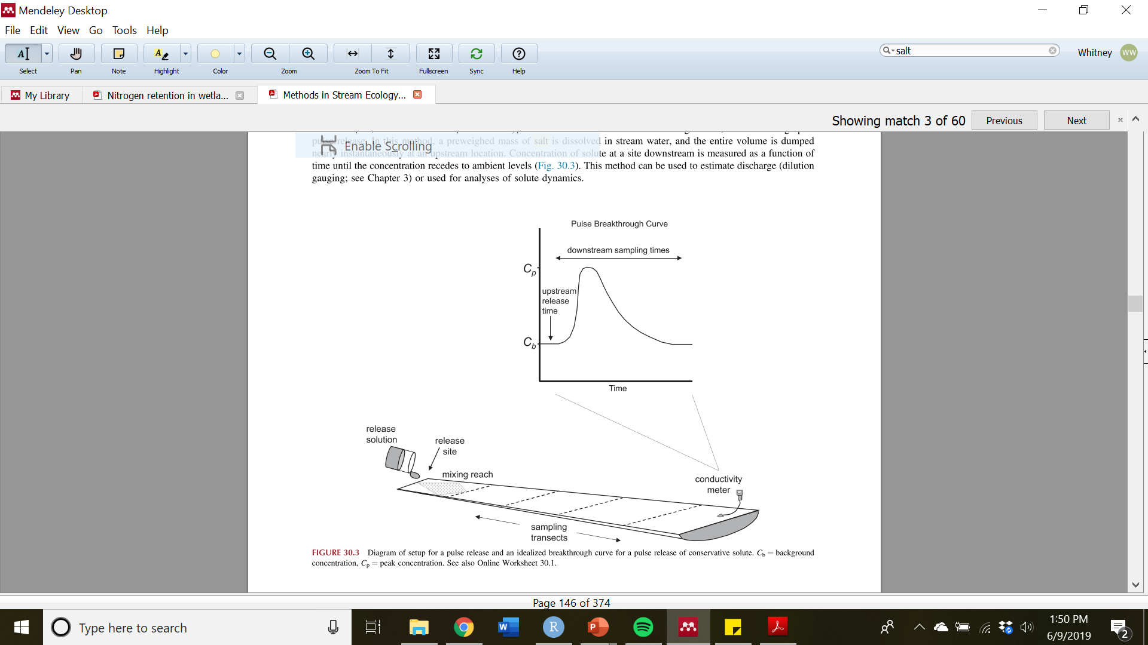
What is a salt slug?
AKA Salt injection
A measurement of flow based on the longitudinal dispersion of a solute through a stream reach
Discharge is calculated as the area under the curve
Hauer and Lamberti 2017

Slide 3
Where should you do a salt slug?
Well-mixed streams with flow of <10 m³/s
1 L/s = 0.001 m³/s
Measurement site
Release site
~10X stream width upstream
A well-mixed part of the stream

Slide 4
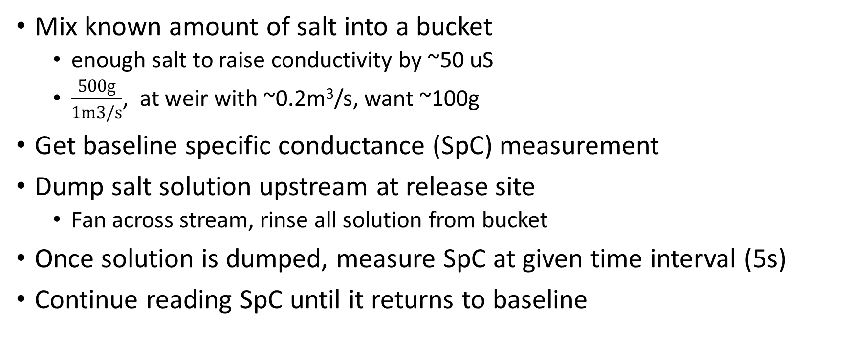
How do you do a salt slug?
Mix known amount of salt into a bucket
enough salt to raise conductivity by ~50 uS
$\frac{500g}{1m3/s}$, at weir with ~0.2m³/s, want ~100g
Get baseline specific conductance (SpC) measurement
Dump salt solution upstream at release site
Fan across stream, rinse all solution from bucket
Once solution is dumped, measure SpC at given time interval (5s)
Continue reading SpC until it returns to baseline

Slide 5
Development of standard curve
Measure SpC of water at stream site over various additions of solute
0
5
10
25
50
100
This will give you a standard curve, the slope of which is used to calculate chloride concentration from SpC

Slide 6
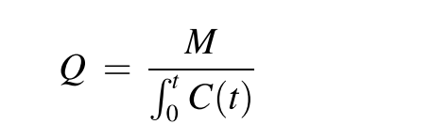
Calculation of discharge, Q
Where
M = mass of solute added
C = concentration
t = time

